Slide 1
Real / Fake Job Posting Prediction
Vishal Hrithik Pullmaddi

Slide 2
Outline
Project Overview
Data Information
Exploratory Data Analysis(EDA)
Algorithms and Techniques
Methodology
Conclusion

Slide 3
Project Overview
Employment scams are on the rise. According to CNBC, the number of employment scams doubled in 2018 as compared to 2017. The current market situation has led to high unemployment. Economic stress and the impact of the coronavirus have significantly reduced job availability and the loss of jobs for many individuals. A case like this presents an appropriate opportunity for scammers. Many people are falling prey to these scammers using the desperation that is caused by an unprecedented incident. Most scammer do this to get personal information from the person they are scamming. Personal information can contain address, bank account details, social security number etc. The scammers provide users with a very lucrative job opportunity and later ask for money in return. Or they require investment from the job seeker with the promise of a job. This is a dangerous problem that can be addressed through Machine Learning techniques and Natural Language Processing (NLP).

Slide 4
Project Overview
This project uses data provided from Kaggle. This data contains features that define a job posting. These job postings are categorized as either real or fake. Fake job postings are a very small fraction of this dataset. That is as excepted. We do not expect a lot of fake jobs postings. This project follows five stages. The five stages adopted for this project are –
1. Problem Definition
2. Data Collection
3. Data cleaning, exploring and pre-processing
4. Modeling
5. Evaluating

Slide 5
Data Information
Columns | Description
job_id | Unique job ID
title | The title of the job and entry
location | Geographical location of the job ad
department | Corporate department (e.g. sales)
salary_range | Indicative salary range
company_profile | A brief company description
description | The details description of the job ad
requirements | Enlisted requirements for the job opening
benefits | Enlisted offered benefits by the employer
contd…

Slide 6
Data Information contd..
telecommuting | True of telecommunication positions.
has_company_logo | True if company logo is present
has_questions | True if screening questions are present
employment_type | Full time, Part time,Contract,etc.
required_experience | Executive, Entry level, Intern, etc.
required_education | Doctorate, Masters Degree, Bachelor, etc.
industry | Automotive, IT, Health Care, Real estate, etc.
function | Consulting, Engineering, Research, sales etc.
fraudulent | Target - classification attribute

Slide 7
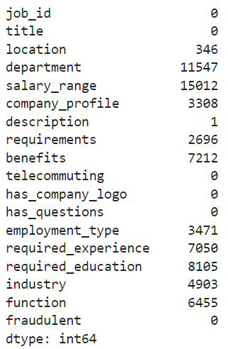
Data Information contd..
Since most of the datatypes are either Booleans or text a summary statistic is not needed here. The only integer is job_id which is not relevant for this analysis. The dataset is further explored to identify null values.

Slide 8
Data Information Contd..
Variables such as department and salary_range have a lot of missing values. These columns are dropped from further analysis.
After initial assessment of the dataset, it could be seen that since these job postings have been extracted from several countries the postings were in different languages. To simplify the process this project uses data from US based locations that account for nearly 60% of the dataset. This was done to ensure all the data is in English for easy interpretability.
Also, the location is split into state and city for further analysis. The final dataset has 10593 observations and 20 features.
The dataset is highly unbalanced with 9868 (93% of the jobs) being real and only 725 or 7% of the jobs being fraudulent.

Slide 9
Exploratory Data Analysis(EDA)

Slide 10
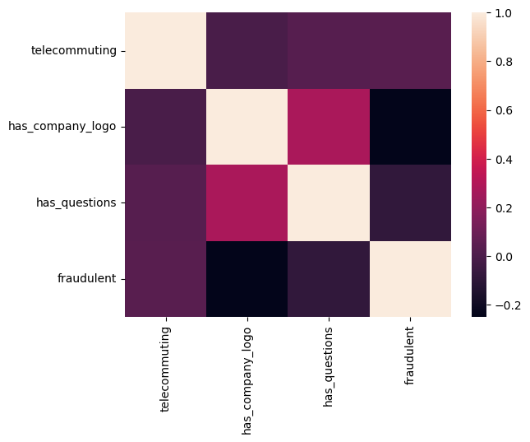
EDA
The correlation matrix does not exhibit any strong positive or negative correlations between the numeric data.

Slide 11
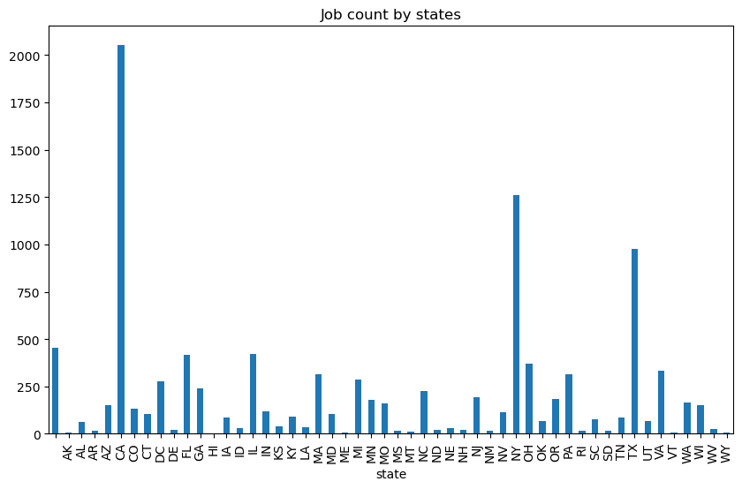
EDA
The graph shows which states produces the greatest number of jobs. California, New York and Texas have the highest number of job postings.

Slide 12
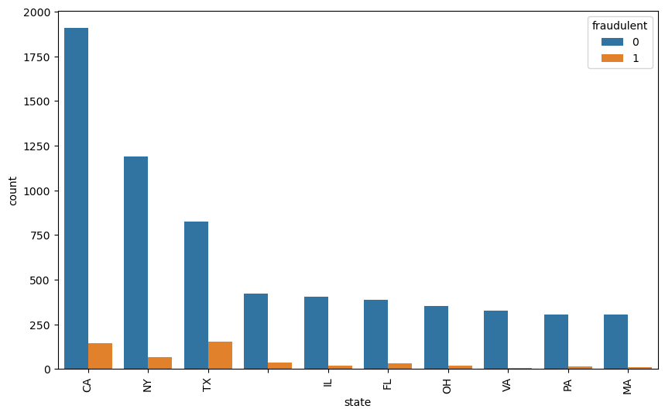
EDA
The graph shows that Texas and California have a higher possibility of fake jobs as compared to other states.

Slide 13
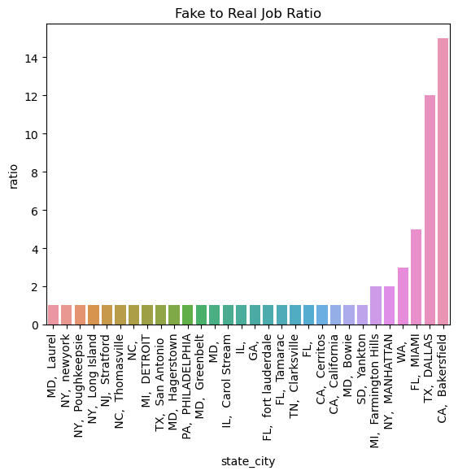
EDA
Only ratio values greater than or equal to one are plotted.
Bakersfield in California has a fake to real job ratio of 15:1 and Dallas, Texas has a ratio of 12:1. Any job postings from these locations will certainly have a high chance of being fraudulent.

Slide 14
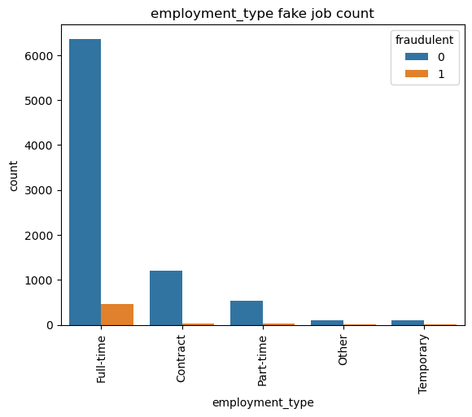
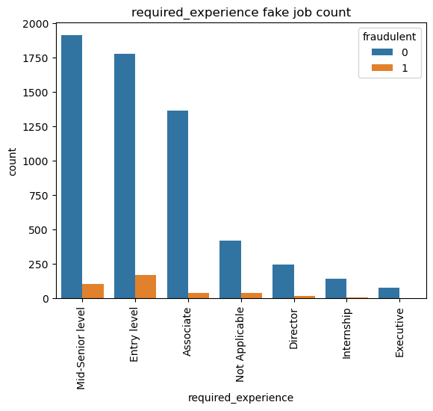
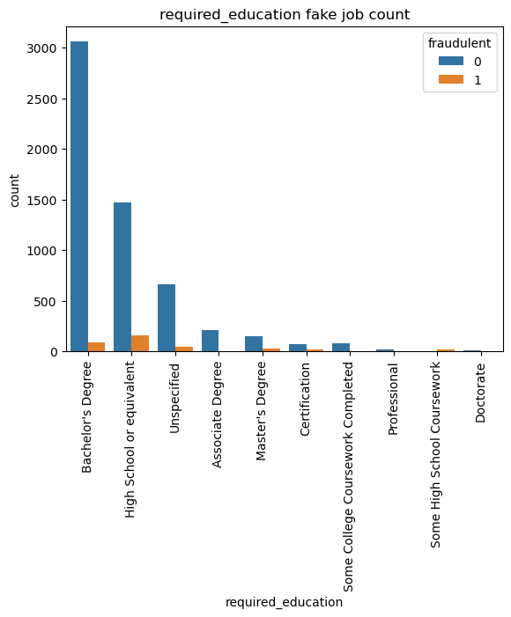
EDA
The graphs below show that most fraudulent jobs belong to the full-time category and usually for entry-level positions requiring a bachelor’s degree or high school education.

Slide 15
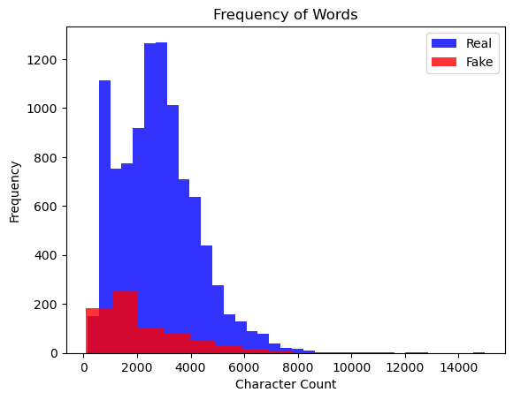
EDA
To further extend the analysis on text related fields, the text-based categories are combined into one field called text. The fields that are combined are - title, location, company_profile, description, requirements, benefits, required_experience, required_education, industry and function. A histogram describing a character count is explored to visualize the difference between real and fake jobs. What can be seen is that even though the character count is fairly similar for both real and fake jobs, real jobs have a higher frequency.

Slide 16
Algorithms and Techniques

Slide 17
Algorithms and Techniques
Based on the initial analysis, it is evident that both text and numeric data is to be used for final modeling. Before data modeling a final dataset is determined. This project will use a dataset with these features for the final analysis:
1. Telecommuting
2. fraudulent
3. ratio: fake to real job ratio based on location
4. text: combination of title, location, company_profile, description, requirements, benefits, required_experience, required_education, industry and function
5. character_count: Count of words in the textual data Word count histogram

Slide 18
Algorithms and Techniques
Further pre-processing is required before textual data is used for any data modeling.
The algorithms and techniques used in project are:
1. Natural Language Processing
2. Naïve Bayes Algorithm
3. SGD Algorithm
Naïve bayes and SGD Classifier are compared on accuracy and F1-scores and a final model is chosen. Naïve Bayes is the baseline model, and it is used because it can compute the conditional probabilities of occurrence of two events based on the probabilities of occurrence of each individual event, encoding those probabilities is extremely useful. A comparative model, SGD Classifier is used since it implements a plain stochastic gradient descent learning routine which supports different loss functions and penalties for classification. This classifier will need high penalties when classified incorrectly. These models are used on both the text and numeric data separately and the final results are combined.

Slide 19
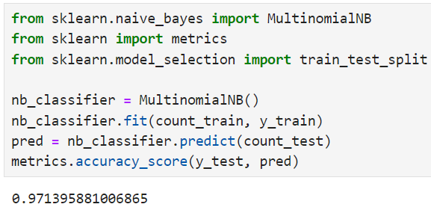

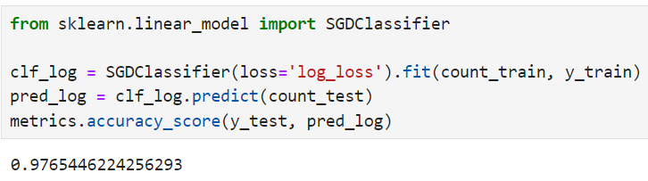
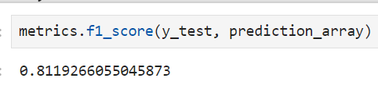
Algorithms and Techniques
The benchmark model for this project is Naïve bayes. The overall accuracy of this model is 0.971 and the F1-score is 0.744. The reason behind using this model has been elaborated above. Any other model’s capabilities will be compared to the results of Naïve bayes.

Slide 20
Methodology

Slide 21
Data Preprocessing
The following steps are taken for text processing:
1) Tokenization: The textual data is split into smaller units. In this case the data is split into words.
2) To Lower: The split words are converted to lowercase
3) Stopword removal: Stopwords are words that do not add much meaning to sentences. For example: the, a, an, he, have etc. These words are removed.
4) Lemmatization: The process of lemmatization groups in which inflected forms of words are used together.

Slide 22
Implementation
The dataset is split into text, numeric and y-variable. The text dataset is converted into a term-frequency matrix for further analysis. Then using sci-kit learn, the datasets are split into test and train datasets.
The baseline model Naïve bayes and another model SGD is trained on the using the train set which is 70% of the dataset. The final outcome of the models based on two test sets – numeric and text are combined such that if both models say that a particular data point is not fraudulent only then a job posting is fraudulent. This is done to reduce the bias of Machine Learning algorithms towards majority classes.
The trained model is used on the test set to evaluate model performance. The Accuracy and F1-score of the two models – Naïve bayes and SGD are compared and the final model for our analysis is selected.

Slide 23
Results
Model Evaluation and Validation
The final model used for this analysis is – SGD. This is based on the results of the metrics as compared to the baseline model. The outcome of the baseline model and SGD are presented in the table below:
Model | Accuracy | F1-Score
Naiive Bayes | 0.971 | 0.743
SGD | 0.975 | 0.811

Slide 24
Conclusion

Slide 25
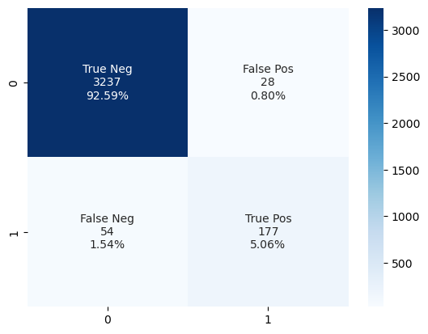
Conclusion
A confusion matrix can be used to evaluate the quality of the project. The project aims to identify real and fake jobs.
The confusion matrix displays the following values – categorized label, number of data points categorized under the label and percentage of data represented in each category. The test set has a total of 3265 real jobs and 231 fake jobs. Based on the confusion matrix it is evident that the model identifies real jobs 99.01% of the times. However, fraudulent jobs are identified only 73.5% of the times. Only 2% of the times has the model not identified the class correctly.

